Slide 1
Security of Mobile
Databases
By
Nimish Joseph
Nitish Rawat
Rahna E

Slide 2
Mobile database as
Distributive Database[1]
Mobile database is a specialized class of distributed database
It includes a distributed database management system (DDBMS), a
distributed database and a network for interconnection.
Data is distributed across multiple databases.
Its functions include distributed `query management, distributed transaction
processing and enforcing security and integrity across the multiple nodes.

Slide 3
Requirements for database management systems
Multi-Level Access Control
Authentication
Confidentiality
Reliability
Integrity
Recovery

Slide 4
Mobile databases can be distributed under two possible scenarios:
The entire database is distributed mainly among the wired components, possibly with full or partial replication.
The database is distributed among wired and wireless components. Data management responsibility is shared among base stations and mobile
units.

Slide 5
Security Problems of
Mobile Database
There are security challenges due to the distributed nature of the application and the hardware constraints of mobile devices.The major issues are:
Authentication:
  User authentication is the primary line of defence for mobile and handheld devices.
  Issue here is the authentication mechanism should be distributed, and the various components of the authenticator need to communicate with each other to authenticate a user.

Slide 6
Data confidentiality:
  Threat- Increase in connection of travelling users to corporate databases to make personal data available to mobile users.
  Solution-C-SDA (Chip- Secured Data Access), which allows querying encrypted data while controlling personal privileges.
Identification
  The process of verifying a user's identity is typically referred to as user identification and authentication.
  Passwords are the common method used for authenticating computer users, but information as name or Passwords provides no assurance of identity, in preventing unauthorized access to computer resources.
  Solution- Use biometrics as methods of user identification.

Slide 7
Access control:
  Access control protects data integrity by limiting who can alter data.
  The access control rules enforced in a distributed environment may be distributed, centralized or replicated.
  Relational database systems implement access control in the SQL language, using the GRANT and REVOKE commands.
  The GRANT command is used to give privileges to users.
GRANT privileges ON object TO users [WITH GRANT OPTION]
  The REVOKE command is used to remove previously granted privileges.

Slide 8
Security Threats of Mobile Terminal
  The resource of mobile terminal is very limited, and data transmission rate is relatively poor. Mobile terminal is usually easy to carry, but also easy to lose and theft.
From the Outside Factors of Database System
  Hacker attacks
  The type of virus, which can make more mobile terminal equipment and backend database damage and attack.
.

Slide 9
Security of Mobile
Network
The Wireless Communication Network Itself:
  Wireless communication network communicates through an open channels.
  It is so easy that a mobile terminal can pretend to be another terminal
  Mobile environment allows users to access any network

Slide 10
Security Strategy to Mobile Database[2][3]
To protect the mobile database security, we must prevent leak, change or damage data and should provide more reliable safety certification.
Safety strategy could better manage protect and distribute the sensitive and important information of mobile database.

Slide 11
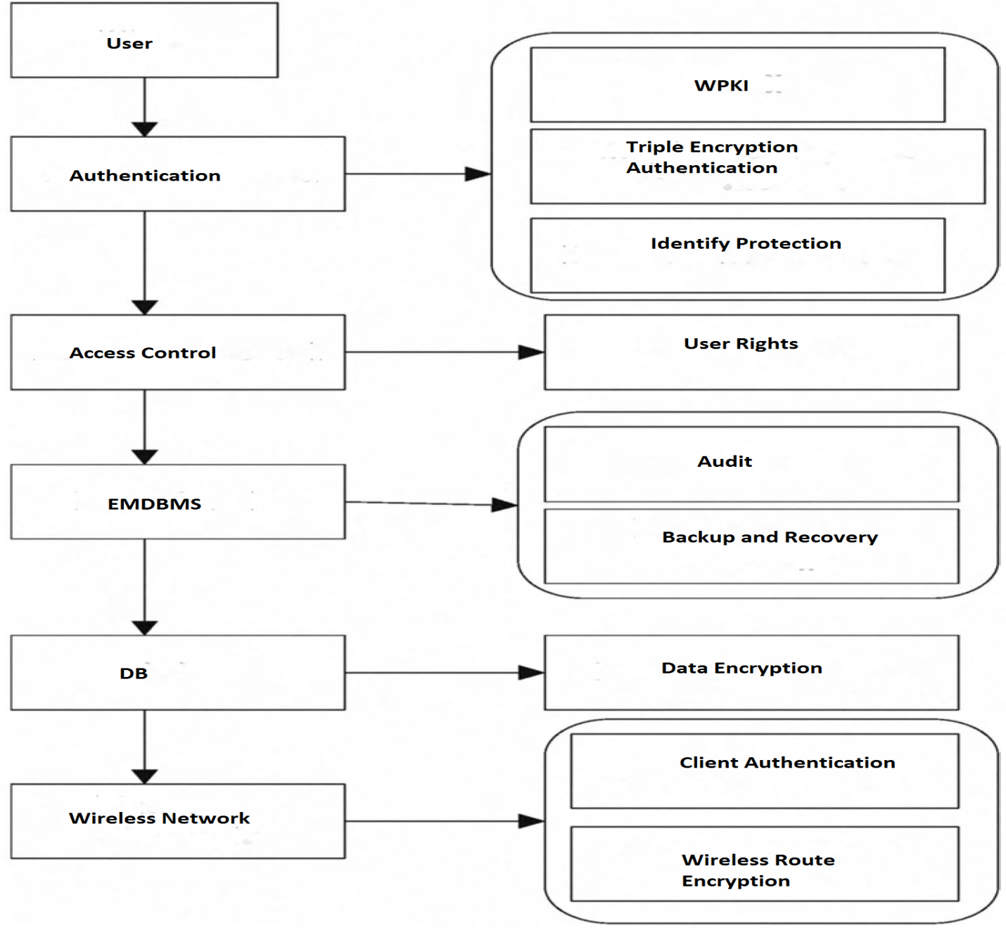
Figure 1. The system safety model of mobile
database

Slide 12
1.Perfecting the Authentication Mechanism
  When it needs to connect or disconnect mobile clients, the mobile database needs to carry on identity verification itself, since the users input their user name and password, so can query, modify the local caching after verification in mobile clients.
  WPKI (wireless public-key system) can effectively solve the problem of identity authentication database.
2.Further Strengthen Storage Access Control
  Users must register to the mobile database and user should be assigned a password and grant their visit corresponding system resources rights. Unauthorized arbitrary users could not use the database resource
3.Strengthen the Encryption of Data
  Password encryption
  Encryption methods, such as the use of elliptic curve cryptography (ECC)

Slide 13
4. Taking the Audit trail and Attack Detection into Account
  The operation record of database could be recorded in the audit log
automatically
  The attack detection system detects the internal or external attacker attempts based on audit data, to track down the responsible person
5. To Improve the Backup and Recovery Capabilities of Mobile
Database
  Tape backup, hot backup, manual backup methods have to be used for safety backup of the database
6. The Security of Wireless Communication Path
  Bluetooth technology- authentication mechanism
  Mobile IP technology - tunneling technology

Slide 14
Open Research Topics[4]
Both vehicles and environment moving
Systems which can cope with uncertain data
Energy Consumption
Performance Evaluation
Mobile database application on GIS

Slide 15
Why Mobile Database
Use in any location.
Offline access to data.
Offers significant savings in network costs.

Slide 16
Applications
Smartphone device application
App store/ Market
GIS / location based system
Weather Broadcast System
Cloud Computing environment

Slide 17
Database providers
Sybase Inc.’s SQL Anywhere
IBM’s DB2 Everyplace
Microsoft SQL Server Compact
Oracle9i Lite
Others...

Slide 18
CONCLUSION
Many different modifications done on this model and research is going on to make this mobile system more convenient and consistent and cost effective.
Though there has many protocols in the area of query optimization and transaction management, we need to improve them to a great extent.
With the continuous promotion of mobile computing technology and use of mobile database technology, the data security becomes an issue. So it's important to continue to explore the security issues of database system in the mobile environment.

Slide 19
REFERENCES
[1] Parviz Ghorbanzadeh, Aytak shaddeli, Roghieh Malekzadeh and Zoleikha Jahanbakhsh, “A Survey of Mobile Database Security Threats and
Solutions for It”
[2] Huaixiang Wang, DeyuDang and Shi Min, “The Analysis of the Security
Strategy of Embedded Mobile Database”
[3] “Mobile Databases: a Selection of Open Issues and Research Directions”, Author manuscript, published in "ACM SIGMOD Record 33, 2 (2004) 78-83".
[4] Parviz Ghorbanzadeh, Aytak shaddeli, Roghieh Malekzadeh and Zoleikha Jahanbakhsh, “A Survey of Mobile Database Security Threats and
Solutions for It”
[4] Le Gruenwald , Frank Olken , “Mobile Database Research: What Is To
Be Done?”

